Slide 1


Mice Protein Expression Classification The aim of this report is to try and identify subsets of protein discriminant to each class using classification

Slide 2

The Dataset has 1080 observations with 82 features.
The data set consists of the expression levels of 77 proteins/protein modifications
There are 38 control mice and 34 trisomic mice (Down syndrome)
The eight classes of mice are described based on features such as Genotype, Behavior and Treatment.
4 categorical columns and 77 numeric columns

Slide 3
Data Preparation
Checking Data types: We make sure that the variables in the dataset are of appropriate datatype(integer, object)
Typos: We identify any sort of spelling mistakes or any kind of data entry errors and fix it accordingly.
Extra white spaces: Unwanted white space can be troublesome and hard to detect during data exploration. Although a minor issue at this step, it creates major issues during exploration if it goes unchecked.
Missing Values: Identification and treatment of missing values in the data frame is crucial as it may lead to inaccurate inference. As part of treatment we impute the missing values with Simple Imputer module of scikitlearn.

Slide 4
Bivariate Descriptive Analysis with Plausible Hypothesis
Investigation to determine relation between proteins using scatter plots
Investigation to determine the similar distribution of specific protein based on genotype.
Investigation to determine behaviour of mice based on the drug injected to them

Slide 5
Data Modelling
Steps:
1. Test-Train Split(50-50, 60-40, 80-20)
2. Tuning Parameters of the Classifier
3. Using Feature Selection technique(Hill climbing)
4. Rerunning the model with selected features on the tuned classifiers
Results
KNN Model-6 in 60-40 and 80-20 split with a best score of 0.99 after feature selection
DT Model-6 in 80-20 split with best score of 0.85 after feature selection.

Slide 6
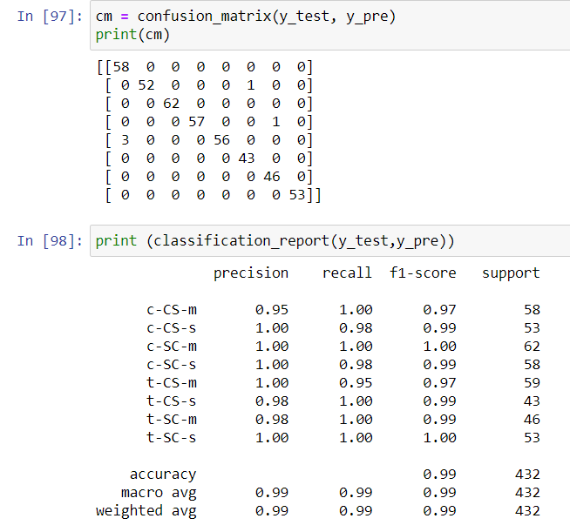
Conclusion
KNN model-6 with feature selection in 60-40 and 80-20 Train-Test split gave accuracy score of 0.99
Two models are the best model amongst the rest as they used less number of features and still gave accuracy score of 0.99
We can save a lot of computational power

Slide 7
Recommendation
Dataset is not too large
Presence of large number of missing values
More Appropriate and precise information
More number of observations would make our model more generalise
Use of Gridsearch in scikit learn would have possibly helped in making even better classifier.

